Slide 1




Delhi Crime Data Analysis Source: :https://www.kaggle.com/datasets/pranaylokhandelp/delhi-crime-data Dataset: DelhiCrime Email: rohithamadala2018@gmail.com Phone :8897911844 LinkedIn : https://www.linkedin.com/in/rohithamadala/
Employees Dataset Analysis Using PySpark
Bharadwaj Kollepara

Slide 2
Introduction
This presentation provides an analysis of the Delhi Accident Data, covering:
Dataset Structure and Accident Record Uniqueness
Distribution of Accident Types
Geographic Patterns across Districts
Vehicle-wise Accident Trends
Year-wise Changes in Accident Frequency
Injury and Fatality Statistics
Road Safety and Urban Planning Insights

Slide 3
Initial Analysis of the Dataset
The dataset contains detailed records of road accidents across various districts in Delhi, spanning multiple years. The key columns include YEAR, DISTRICT, VEHICLE AT FAULT, VICTIM, TYPE OF ACCIDENT, # INJURED, and # KILLED. There are thousands of rows, with each representing an individual accident event. Data completeness is strong, with no major missing values, ensuring reliability for further exploration.
1. Structure and Uniqueness
The dataset comprises accident events described by several categorical and numerical features. Each row represents a unique incident, distinguished by a combination of year, district, vehicle type, and other attributes. Various districts and vehicle types are well represented, capturing a broad scenario of Delhi’s road safety profile. Columns are clearly defined for accurate analysis, with unique values identified for accident types and victim groups.
2. Departmental Distribution
Accidents are categorized into types such as “SIMPLE ACCIDENT,” “FATAL ACCIDENT,” and “NON INJURY.” The majority of records fall under simple accidents, while fatal accidents account for a significant portion, highlighting ongoing safety concerns. Non-injury cases are relatively less frequent. Understanding this distribution aids in prioritizing accident prevention strategies.

Slide 4
Initial Analysis of the Dataset
3. State-wise Representation
Records span all major districts in Delhi, including New Delhi, South East Delhi, North Delhi (Rohini), and others. Accident counts differ by district, with some areas showing higher incident rates. Such geographic diversity is crucial for localized policy interventions and resource allocation in public safety and urban planning.
4. Vehicle-wise Trends
The 'VEHICLE AT FAULT' column reveals which vehicle types are most frequently involved in accidents. Private cars, unknown vehicles, and certain commercial types feature prominently. The data helps identify which vehicle categories require stricter regulations or public awareness campaigns.

Slide 5
Initial Analysis of the Dataset
5. Injury and Fatality Insights
Injured and killed statistics per accident vary widely, with some incidents resulting in multiple casualties while others record none. The distribution of these numeric features provides a basis for assessing the severity and outcomes of road accidents in Delhi, allowing calculation of averages, medians, and other summary statistics.
6. Year-wise Trends
Analysis shows changing accident frequencies over the years, with certain years marking notable spikes or declines. Improvement in accident numbers likely reflects changes in road safety policies, infrastructure, or traffic volumes.

Slide 6
Initial Analysis of the Dataset
7. Key Relationships
Accident Type vs. Severity: Fatal accidents typically involve higher numbers of injured and killed.
District vs. Incident Rate: Some districts show concentrated accident hotspots.
Vehicle Type vs. Casualties: Certain vehicle categories correlate with higher accident impacts8. Workforce Characteristics

Slide 7
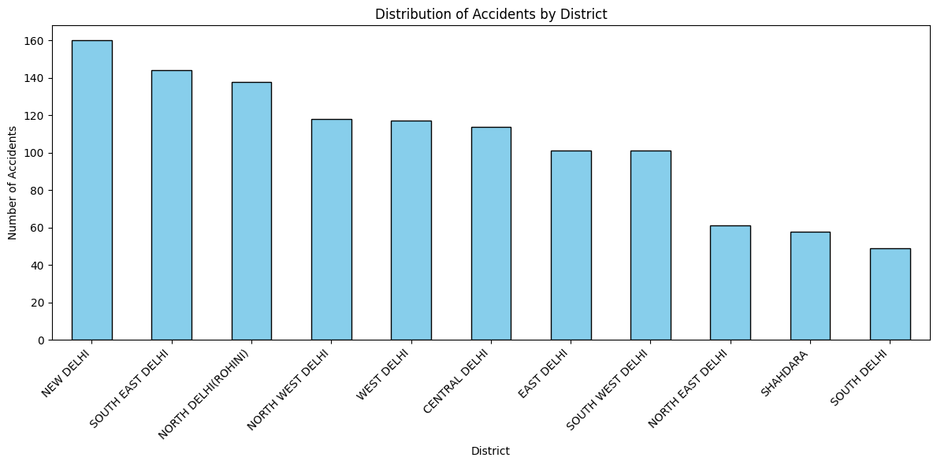
Distribution of Accidents by District
New Delhi district has the highest recorded accidents, indicating a high-risk zone.

Slide 8
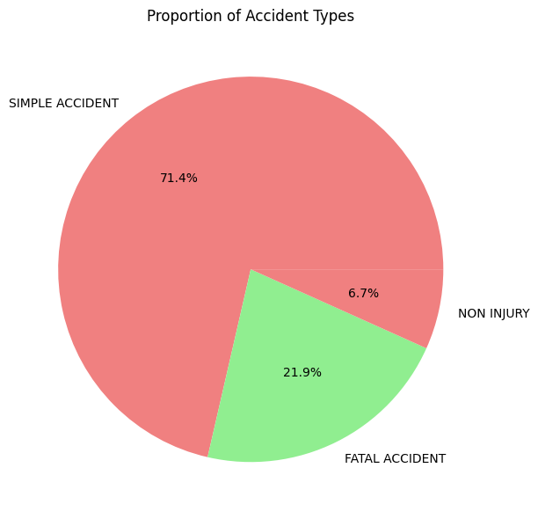
Proportion of Accident Types
The dominance of simple accidents suggests most road incidents are non-fatal, but the 21.9% share of fatal accidents underscores an urgent need for targeted safety measures and interventions to reduce severe outcomes on Delhi's roads.

Slide 9
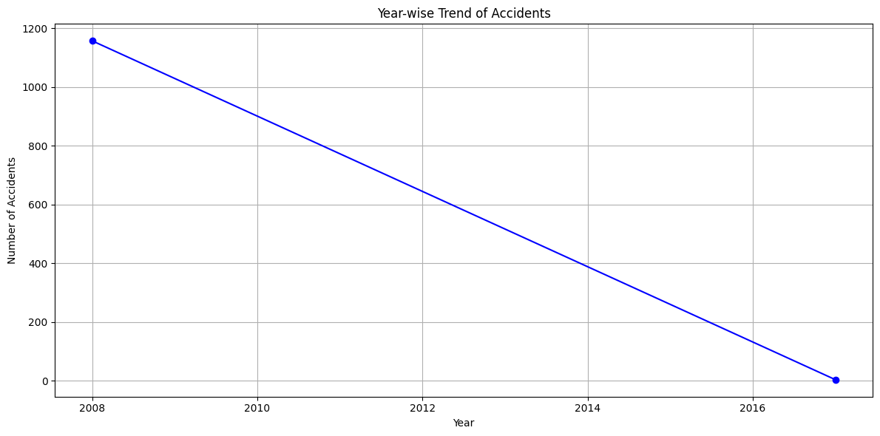
Year-wise Trend of Accidents
The downward trend could be attributed to the implementation of improved road safety regulations, enhanced traffic management, or other infrastructural developments. This positive change highlights the effectiveness of targeted policy measures and increased public awareness.

Slide 10
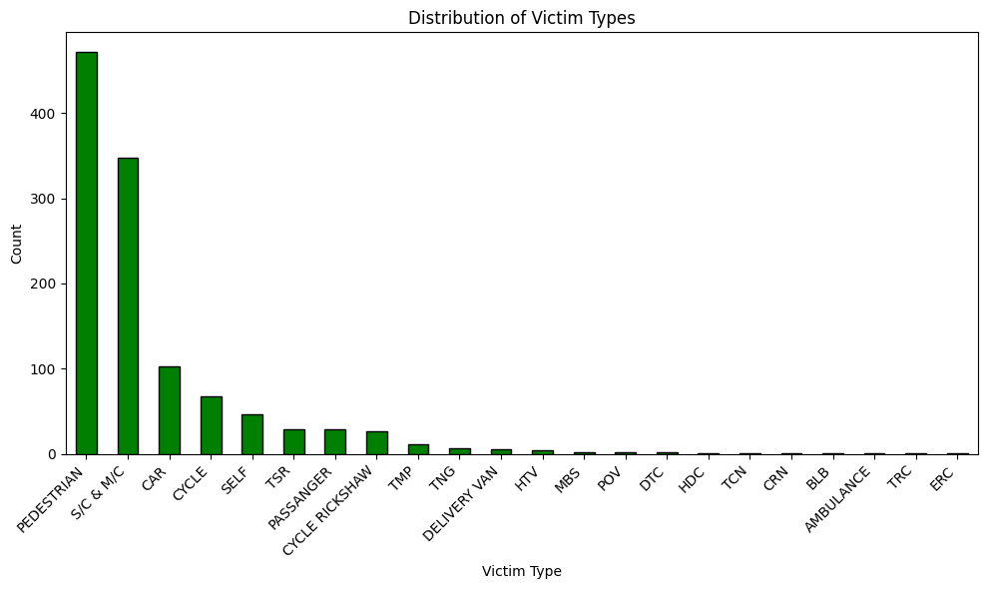
Distribution of Victim Types
The chart demonstrates that vulnerable road users—pedestrians, two-wheeler riders, and cyclists—constitute the largest share of accident victims. This underscores the need for enhanced pedestrian safety measures, better rider protection, and robust enforcement of traffic regulations for two-wheeler vehicles in Delhi.

Slide 11
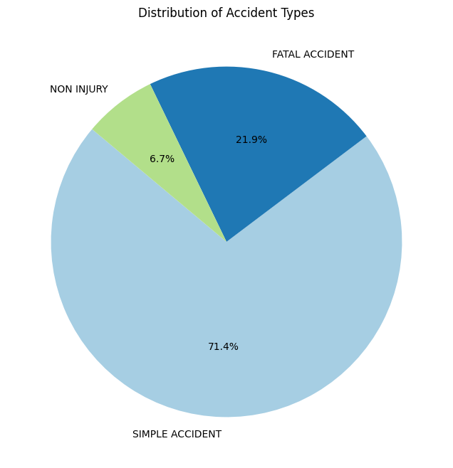
Distribution of Accident Types
While most reported accidents are simple in nature, the significant share of fatal accidents highlights the importance of ongoing road safety measures and targeted interventions to prevent severe outcomes.

Slide 12
Dataset Observation
Injury Count Distribution
The number of injured persons per accident varies widely, but most accident records involve a lower count of injured individuals.
Accidents with high injury counts are less frequent, indicating that severe injury incidents are relatively rare but critical.
Severity & Casualty Insights
The fatality count per accident shows that while most incidents have zero or few deaths, the fatal accidents contribute significantly to overall casualty numbers.
The variation in injury and fatality counts suggests a range of accident severities from minor to catastrophic..

Slide 13
Conclusion
Delhi’s accident dataset reveals persistent road safety challenges, with highest fatalities among Indian cities. Accidents are prevalent across districts and mainly impact pedestrians and two-wheeler users. The data supports critical analysis for future traffic management, infrastructure, and injury prevention planning in Delhi’s transport system.

